Slide 1
Address bus
Data bus
Types of Communication CPU Buses
Control bus
Done by: Mohamad Luqman Idlan bin Mohamad Azahari
Matric: 1723539

Slide 2
1. Address Bus- carries memory addresses from the processor to other components such as primary storage and input/output devices. The address bus is unidirectional. 2. Data bus - carries the data between the processor and other components. The data bus is bidirectional 3. Control bus - carries control signals from the processor to other components. The control bus also carries the clock's pulses. The control bus is unidirectional

Slide 3
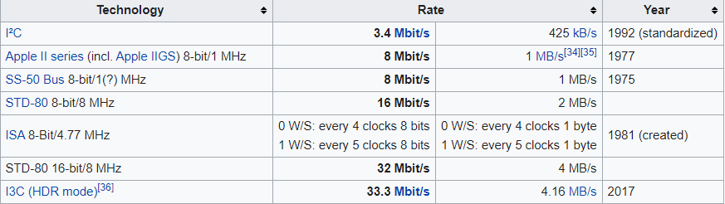
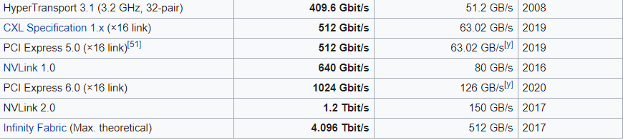
EXAMPLES OF BUSSES
Main buses

Slide 4
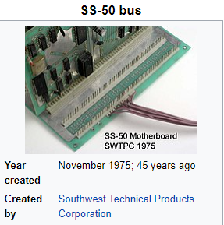
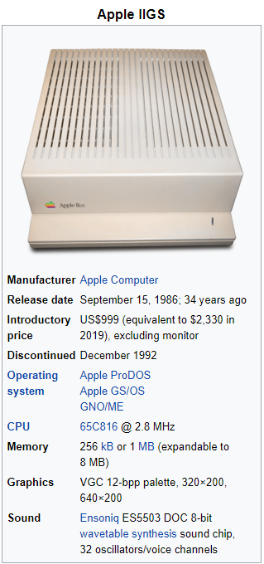
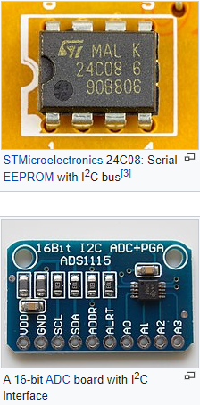
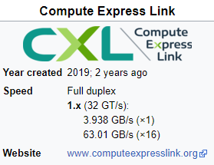

Slide 5
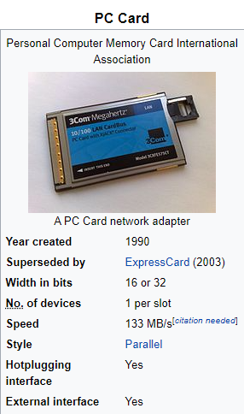

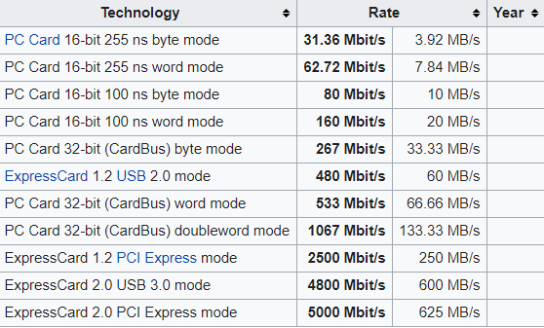
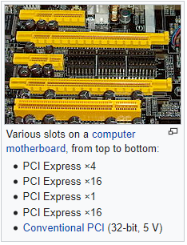
Portable

Slide 6
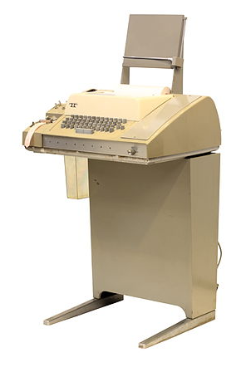
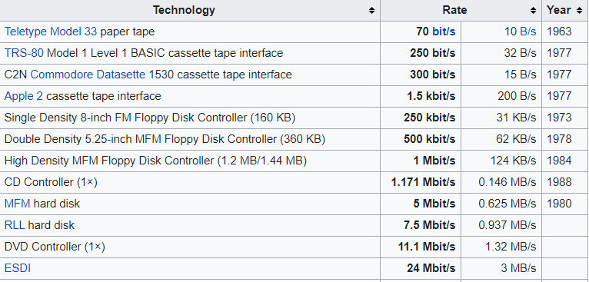
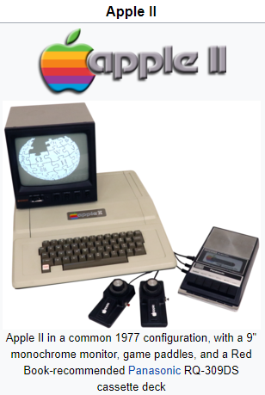
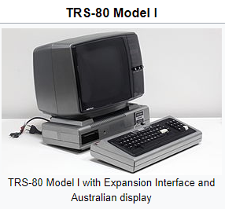
Storage

Slide 7
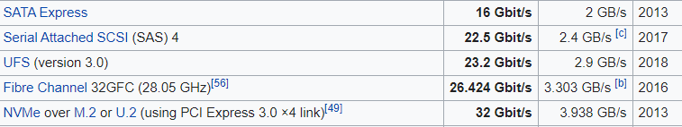
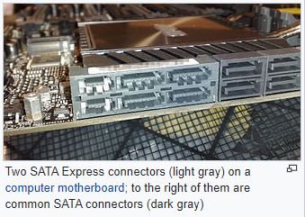
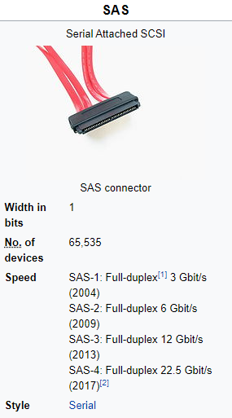
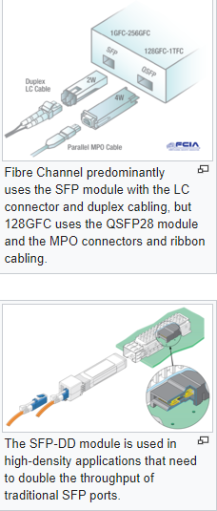
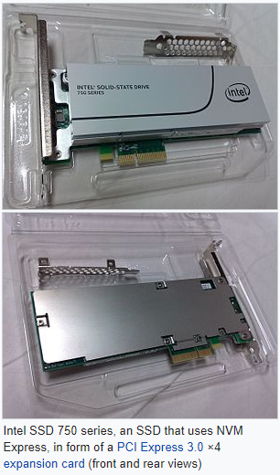

Slide 8
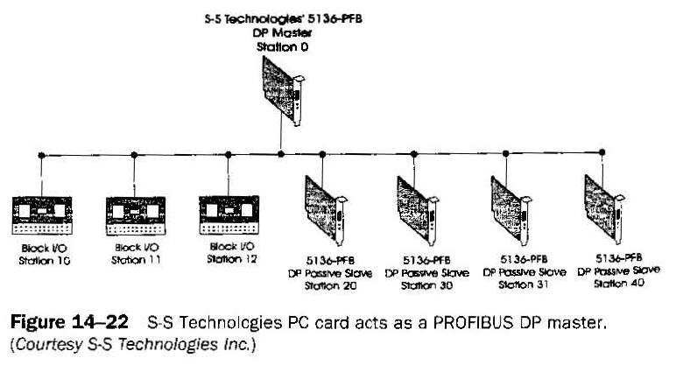
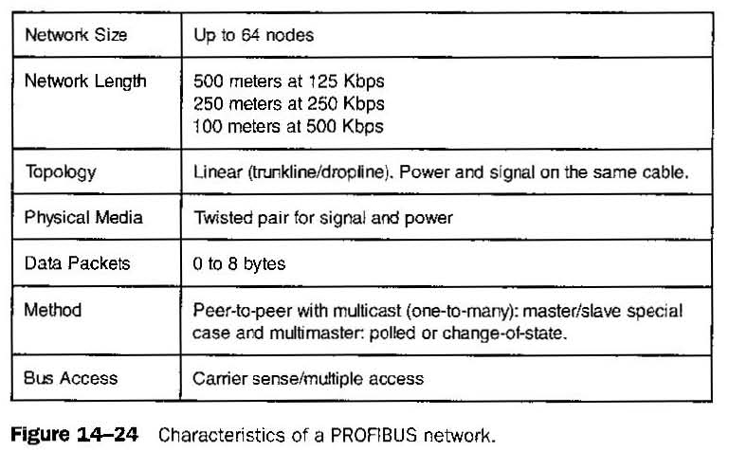
PROFIBUS (Process Field Bus)
Supports high-speed applications in discrete manufacturing such as motor starters, actuators. cell control, and remote I/O. Slaves can respond only to received messages or send messages at the master's request. Master devices have the capability to control the bus.

Slide 9
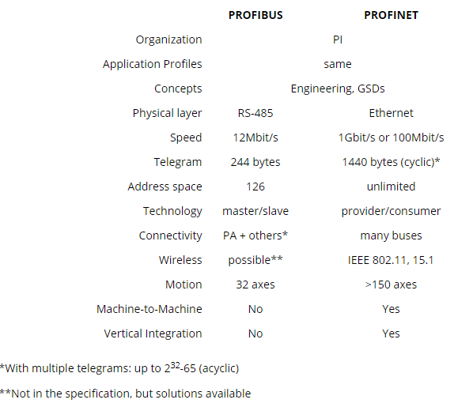
PROFINET
PROFINET networks achieve speeds of 100 Mbit/s or even 1 Gbit/s and higher. The telegram size can be up to 1440 bytes, and there are no limits on the address space. Uses Ethernet instead of RS-485

Slide 10
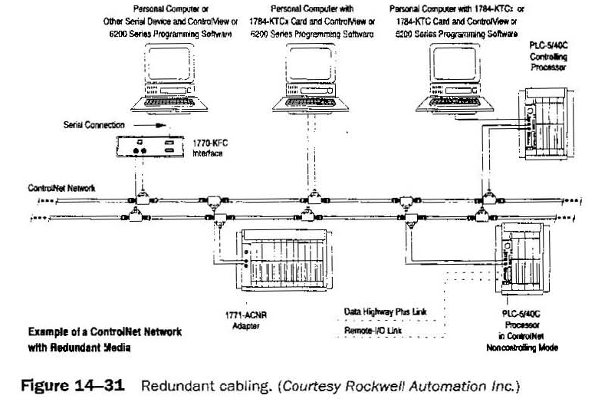
ControlNet
ControlNet is a high-speed, deterministic network developed by Allen-Bradley for transmitting critical automation and control information. Control Net can perform multiple functions including multiple PLCs, man/machine interfaces, network access by PC for programming and troubleshooting from any node.

